Slide 1
Sensors!
Willl Angel
Linkedin: https://www.linkedin.com/in/william-angel/
Twitter: @DataDrivenAngel

Slide 2
Overview
Presentation
Sensors
Sensor Data extraction
Sensor Data Storage
Demo
Arduino sensors
ESP8266 Sensor Network Overview

Slide 3
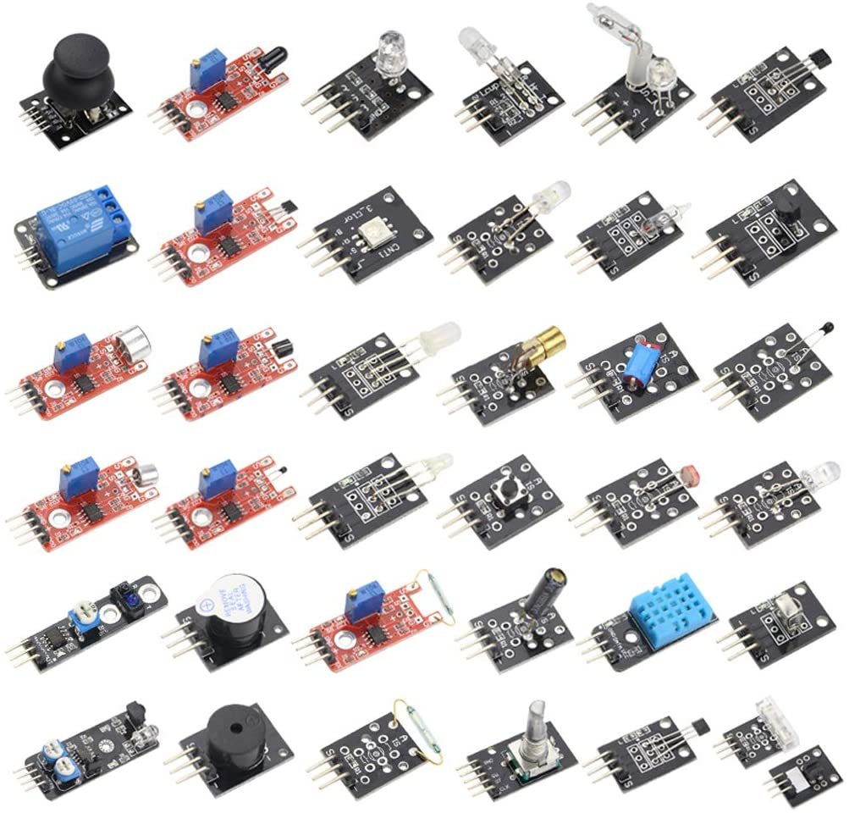
What is a sensor?
“a device that responds to a physical stimulus (such as heat, light, sound, pressure, magnetism, or a particular motion) and transmits a resulting impulse (as for measurement or operating a control)” -Merriam-Webster
“a device, module, machine, or subsystem whose purpose is to detect events or changes in its environment and send the information to other electronics” -Wikipedia

Slide 4
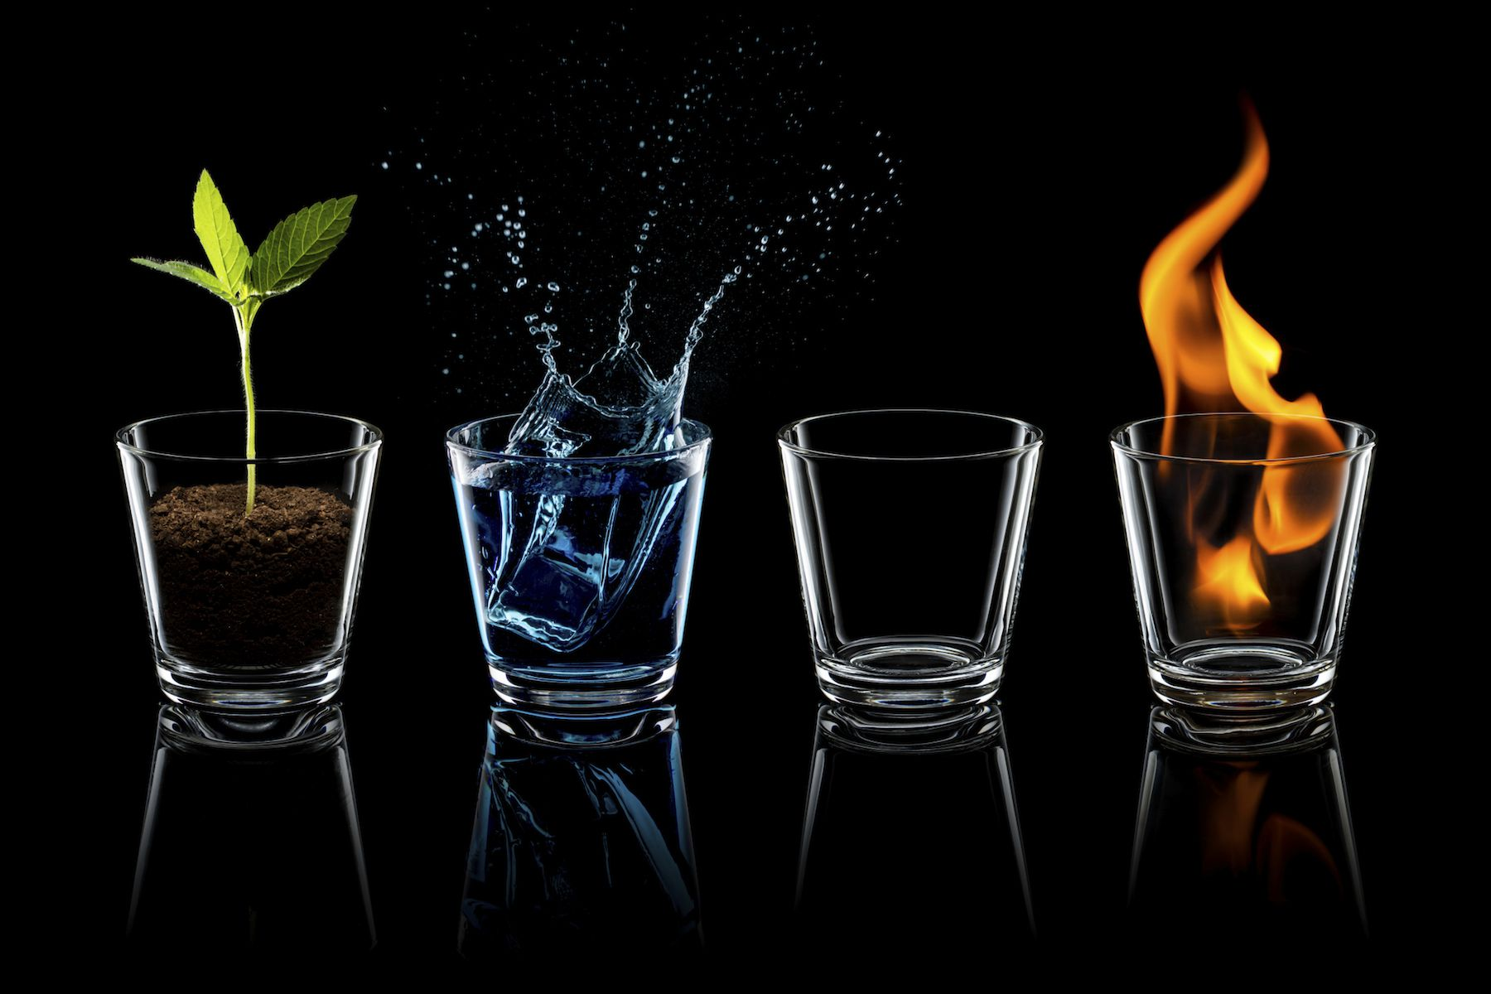
What kinds of data do sensors collect?
Anything! - Temperature - Electrical Voltage/Current - Distance - Time - Force / Mass / Pressure - Light - Acceleration - Images - Sound - Fluid Flow

Slide 5
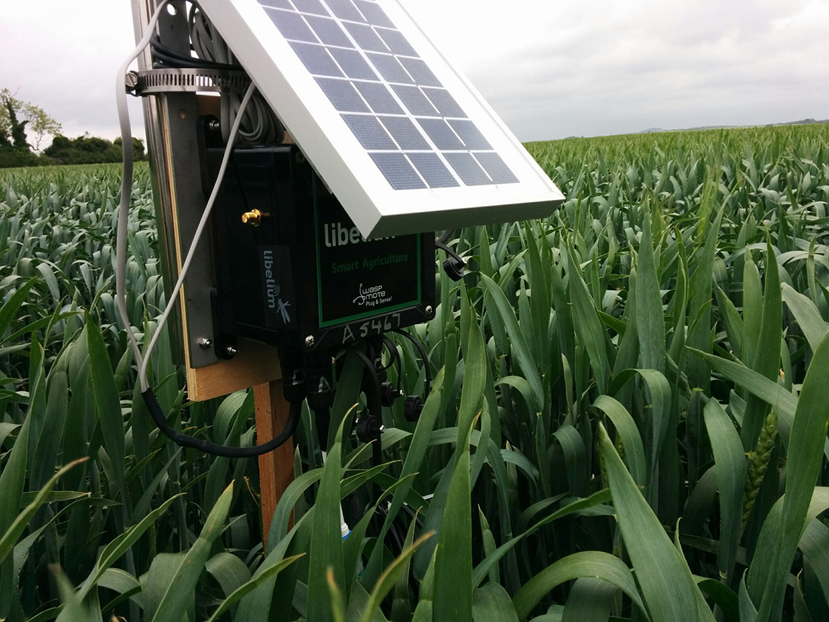
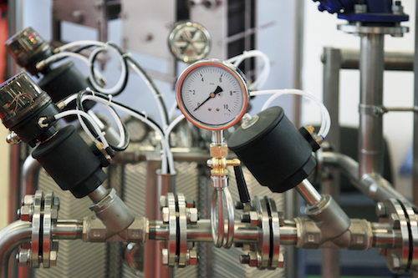
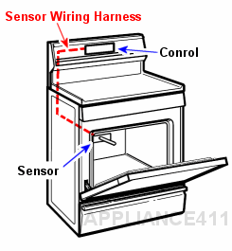
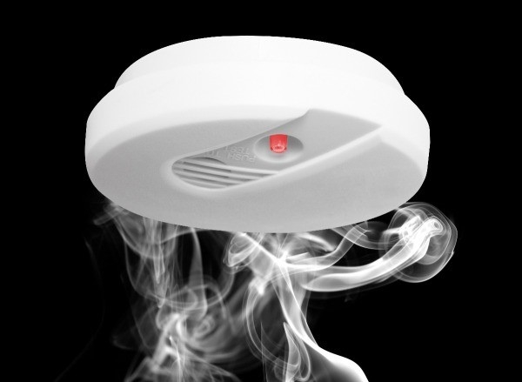
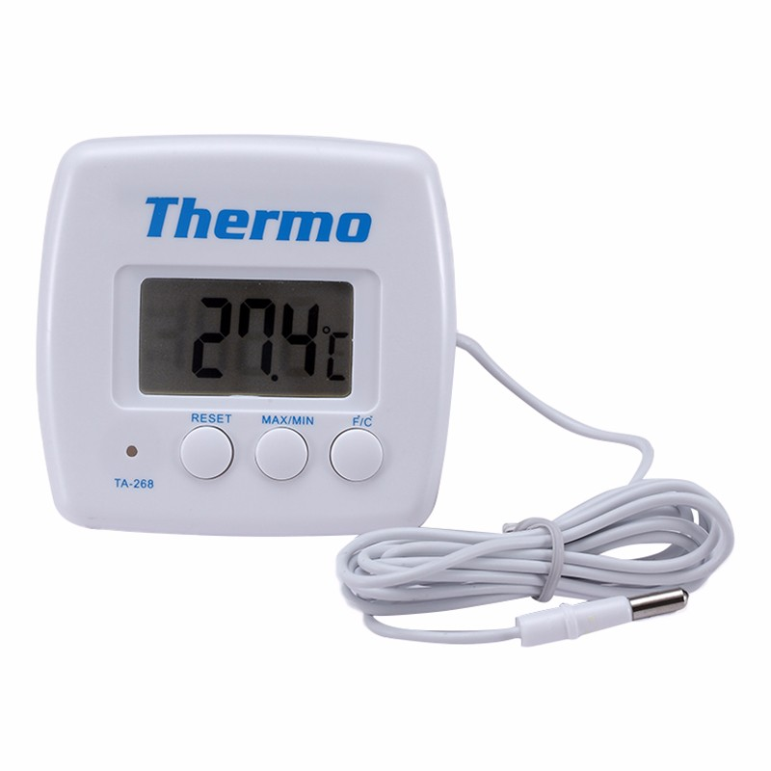
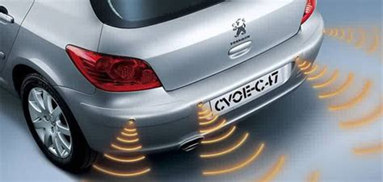
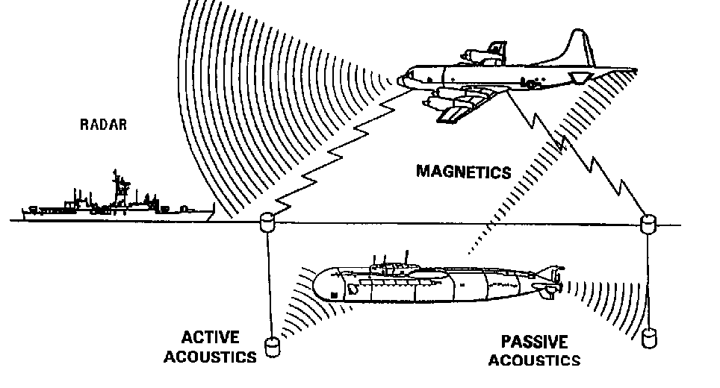
Where do we use sensors?
EVERYWHERE!

Slide 6
When do we use sensors?
When the data is necessary
When the data can be useful
When the sensors and controllers are so cheap that you might as well just put them in and get data.

Slide 7
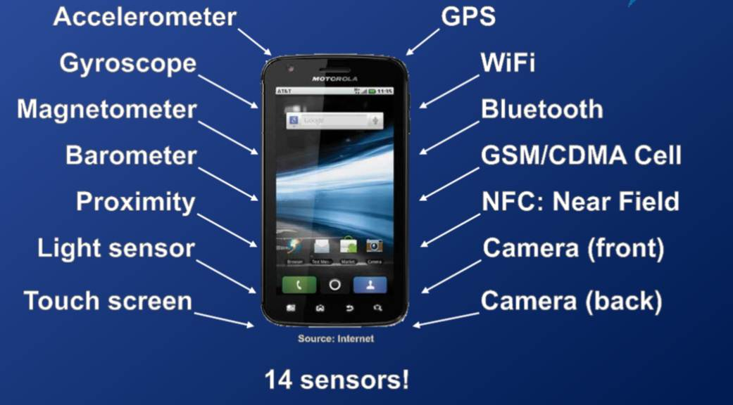
Microelectromechanical Systems (MEMs)
Semiconductor fabrication allows sensors to be miniaturized and produced in larger quantities at lower costs and higher qualities. We live in a golden age of sensors.

Slide 8
Microcontrollers:
Tiny (and cheap) computers
Semiconductor Manufacturing has made computers smaller, cheaper, and more efficient. A $3 microcontroller today has more computing power than NASA used to send astronauts to the moon. A $40 Raspberry Pi 3 Linux Computer has four times the power of a CREY-2 Supercomputer (5.3 gflops vs 1.4 gflops) The cost of paying a college student to set one of these up is more than the hardware.

Slide 9
How do useful sensors measure?
A useful sensor measures:
Sensitively: responds to the desired physical change in a predictable way that allows the physical property to be measured with some accuracy.
Insensitively: does NOT respond to other physical changes that are likely to co-occur with the desired measure.
Impact free: does NOT change the physical property it measures.

Slide 10
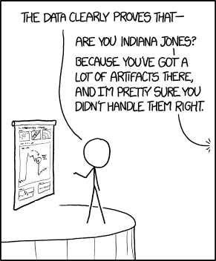
The Pitfalls of Sensor Data

Slide 11
Pitfalls of Sensor Data
Sensors are Physical devices:
Not perfectly sensitive under all conditions: results in measurement error
Vibration, heat, light, moisture, poor calibration, manufacturing defects, can chance the sensitivity of a sensor and cause it to give inaccurate readings.
Not always available: results in intermittent data
Power loss, network disruptions, Bob from IT unplugs a cable, a bird steals your camera, the sensor breaks, someone disables the smoke alarm so they can vape, someone steals the sim card from your remote sensor node and racks up €1500 in roaming charges, etc

Slide 12
Pitfalls of Sensor Data - Continued
Sensor data comes from systems
Distributed computer systems are terrible:
Networking is hard
Hardware cannot be trusted
Things break - sometimes they only partially break
Not always available or timely:
Sensors break, data gets delayed, measurements conflict,
Sensor data collection computers break or degrade

Slide 13
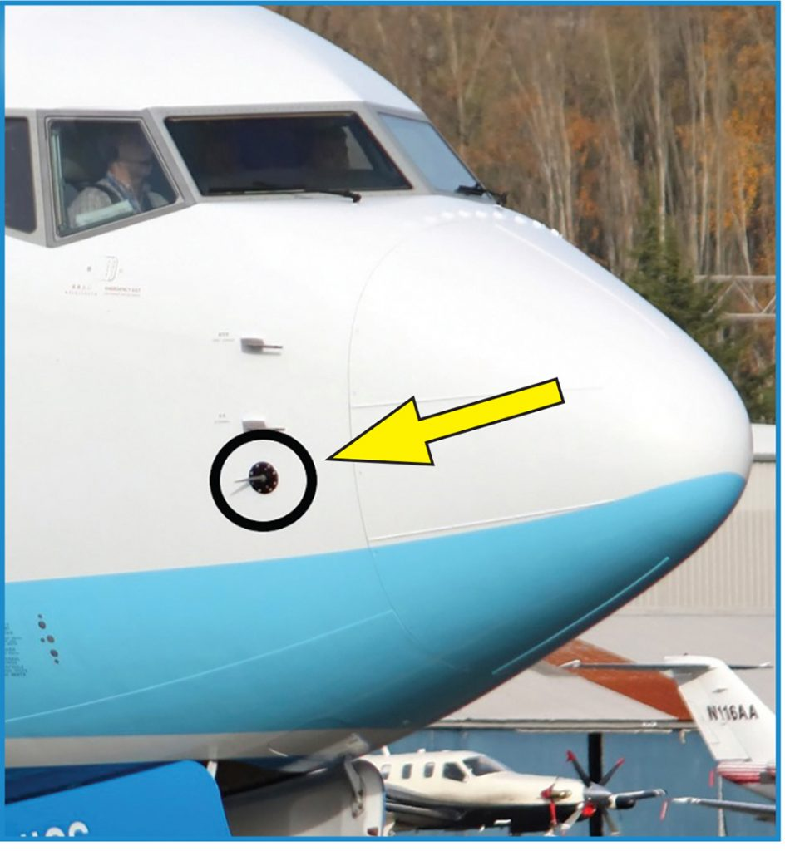
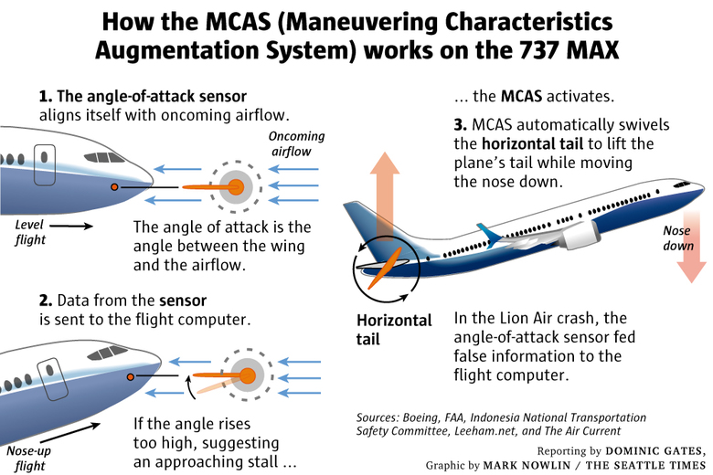
346 reasons to avoid data pitfalls

Slide 14
Tips to avoid sensor data pitfalls: Trust no one, not even yourself
As a system designer/operator:
Be Paranoid: Cultivate an Operations Mindset and anticipate potential faults
Build redundancy and monitoring
As a data practitioner working with data from sensors:
Understand where the data comes from and how it is collected
Look for anomalies, missing data, incomplete data, wrong data, mislabeled data.
Bootstrap trust: look for sensor readings that can be used to increase confidence in other sensors.

Slide 15
Data Extraction
How do we get data out of a sensor anyways?

Slide 16
Data Extraction
Sensor Data is useful when:
A human sees the data
A human could see the data ( but doesn’t want to)
An algorithm uses the data

Slide 17
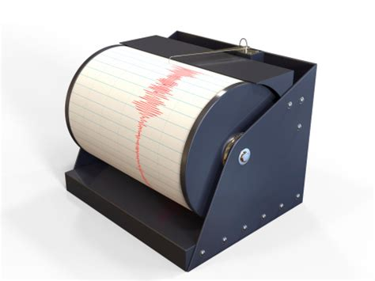
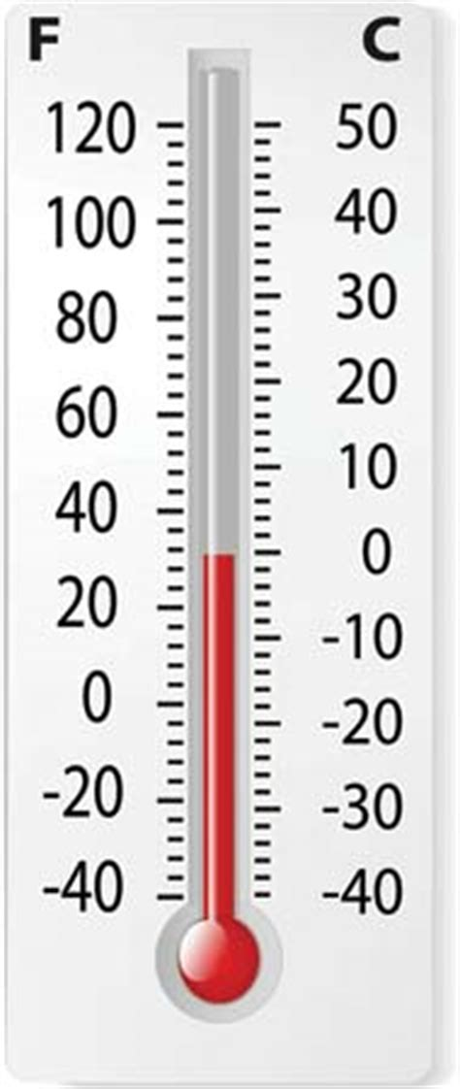
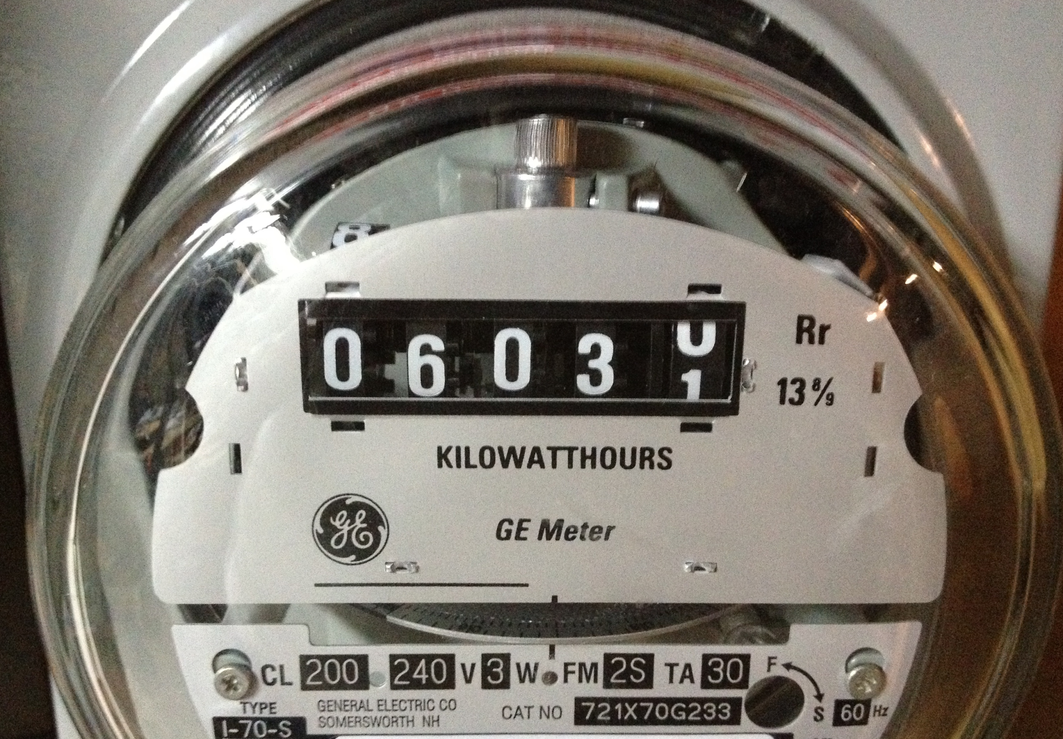
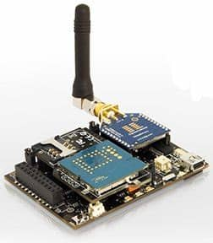
Methods for sensor reading:
Data can be read from a sensor:
Manually
Mechanically
Electrically
Digitally

Slide 18

Methods for data extraction:
Data can be extracted from a digital sensor and sent to storage:
By Wires:
Electrical
Optical
By radio
2G SMS
3G+ Cellular data
Bluetooth
RFID
WiFi
LoRa Radio
Packet Radio
Microwave Relays
Satellite / space communications
By light
Lasers!
By Audio:
Phone modem
Speaker + Microphone
Ultrasound

Slide 19
Data Storage
Where do we put all this junk data?

Slide 20
Methods for data Storage:
Sensor data needs to be stored somewhere
Put it on a flash drive ~100GB
Put it on a hard drive ~ 10 TB
Put it on a server ~ 100 TB
Put it on a rack ~ 1 PB
Put it on a data center ~ 100 PB
Build a new google ~ 10 exabytes

Slide 21
Data frequency vs data storage
Data volumes get out of control with high resolution high frequency sensors.
~1 TB of data per aircraft flight
Recording a 4 byte integer at 10khz (10,000/s) is 3.2 GB per day. 1.2 TB per year. PER SENSOR.
Large scale sensor nodes can be thousands or millions of nodes

Slide 22
Datapocalypse: too much data
Storage systems are overwhelmed by the growth in sensor data
Organizations are overwhelmed by the growth in data.
This data will only get bigger, better, and contain more potential value Q.E.D. Data Related Careers will stay in demand

Slide 23
Questions & Demo
Linkedin: https://www.linkedin.com/in/william-angel/
Twitter: @DataDrivenAngel
Github: DataDrivenAngel

